Slide 1
Welcome to our page!
This web application was created by
YAGAVI K – CSE(721220104063)

Slide 2
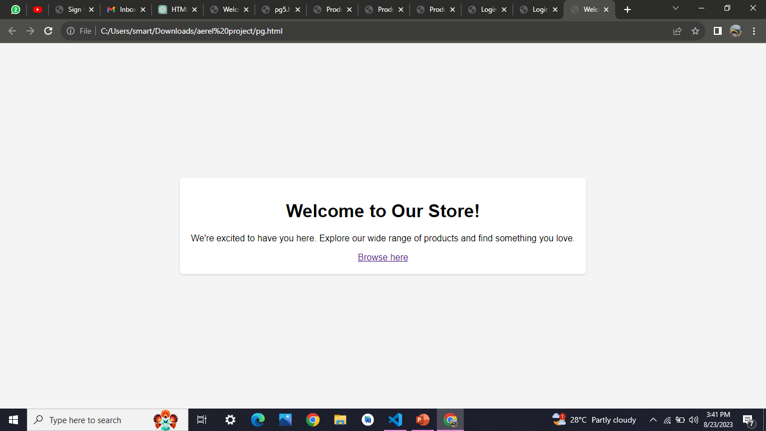
Home Page slide

Slide 3
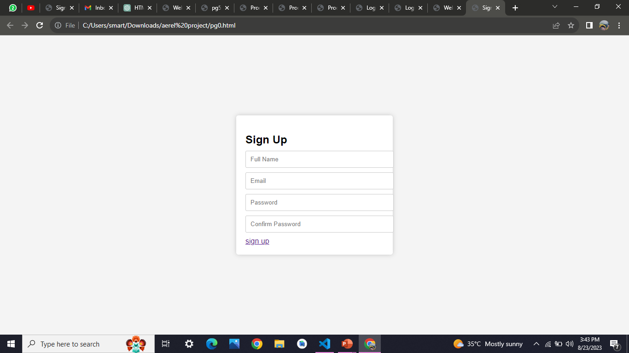
Sign Up slide

Slide 4
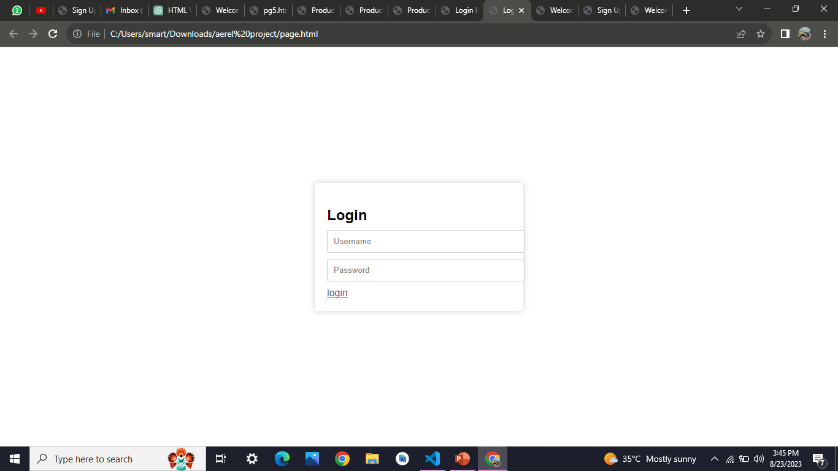
Login slide

Slide 5
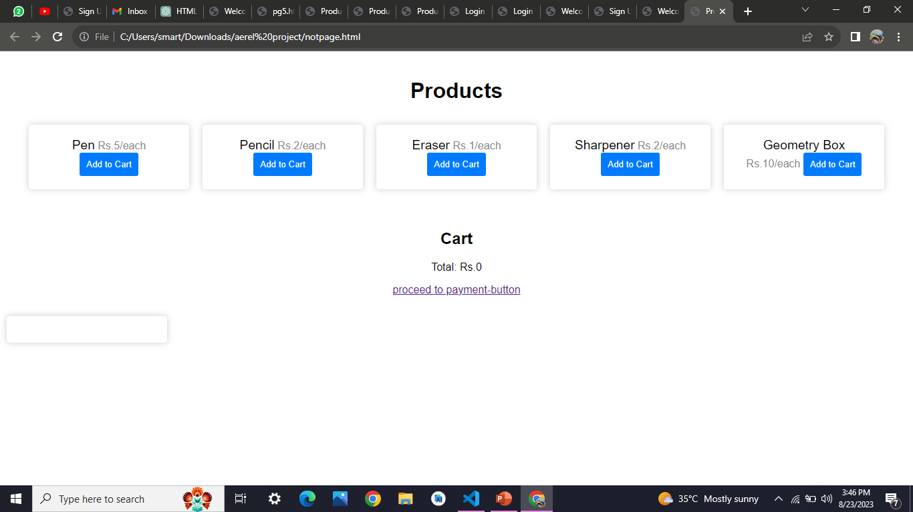
Products slide

Slide 6
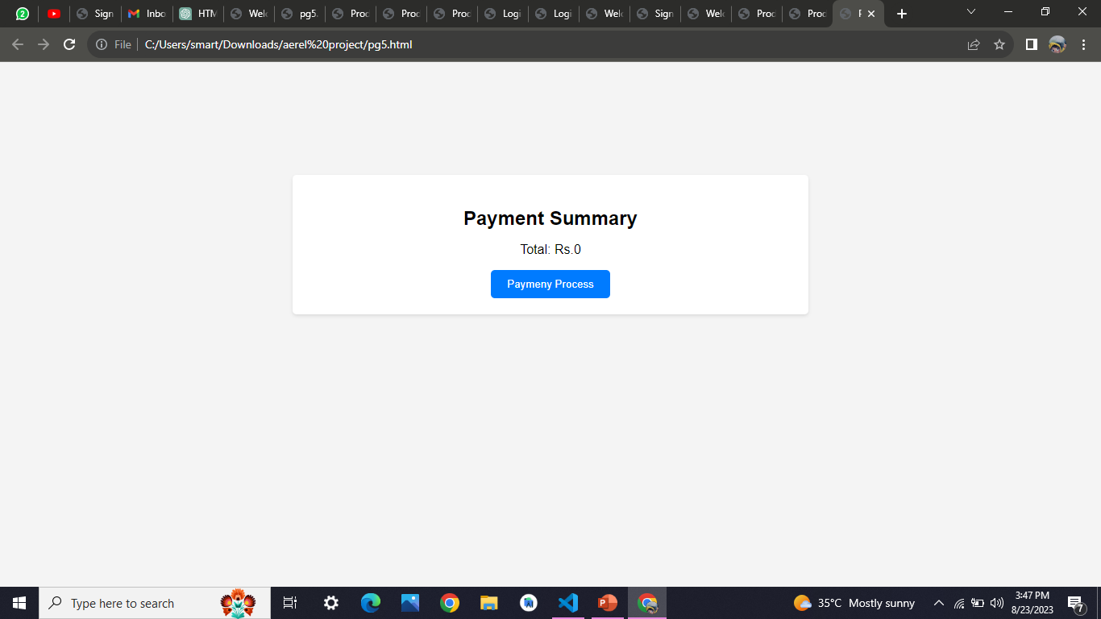
Payment Summary slide

Slide 7
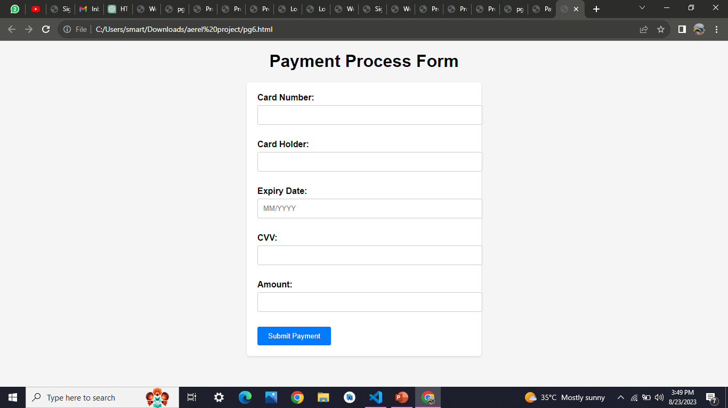
Payment Process Form slide

